Slide 1

Programming Languages
CS2S567: Professional Practice and Employability
________________________________________________________________________
Jessica Fealy – 18024092 Eduard Tenev – 18068234
Komal – 30010813 Harry Pearce – 18136044
Ben Harrison - 18142915

Slide 2
Ed

Slide 3

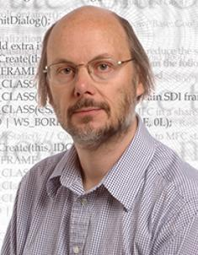

C++ Origins and History
Danish computer scientist Bjarne Stroustrup, is the man responsible for developing C++
Jessica Fealy - 18024092

Slide 4







C++ Major uses
Jessica Fealy - 18024092

Slide 5
Ben

Slide 6
Harry

Slide 7
Komal

